Slide 1

Lecture: 8
Profit and Loss

Slide 2
Contains:
Number of Articles
Faulty Weights((Dishonest Trader)
Problems on Successive Discount

Slide 3
Number of Articles

Slide 4
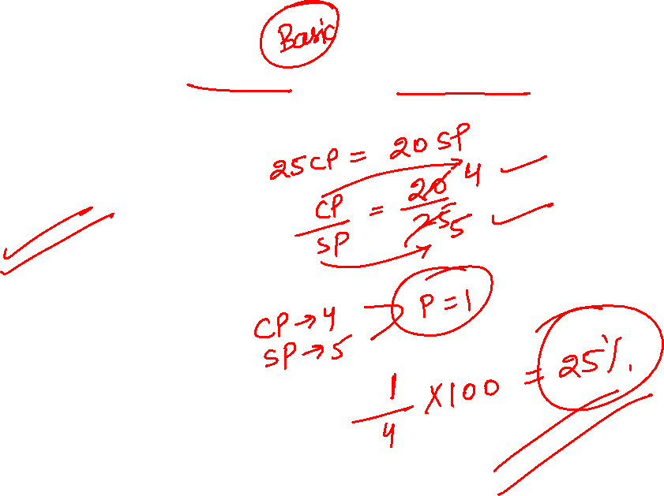
Question: If CP of 25 articles is equal to SP of 20 articles. Find the profit or loss percent.
[A] 25% loss
[B] 25% profit
[C] 20 % profit
[D] 20 % loss

Slide 5
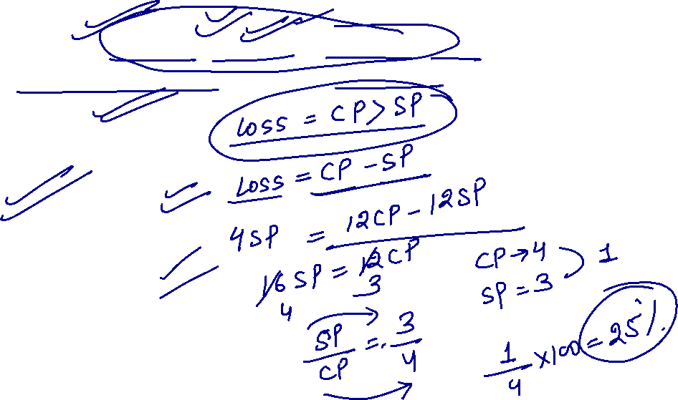
Question: By selling 12 articles a man earn a loss of which is equal to selling price of 4 articles. Find his loss percent.
[A] 20 %
[B] 25%
[C] 33.33%
[D] 16.66 %

Slide 6
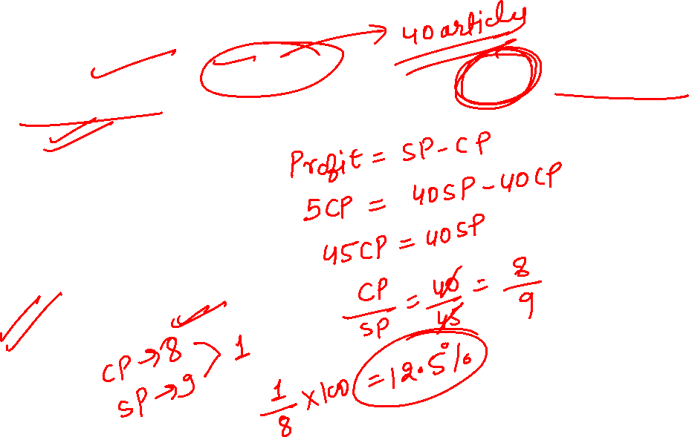
Question: By selling 40 articles a man earn a profit of equal to cost price of 5 articles. Find his loss or profit percent.
[A] 33.33 % profit
[B] 12.5 % loss
[C] 25 % loss
[D] 12.5 % profit

Slide 7
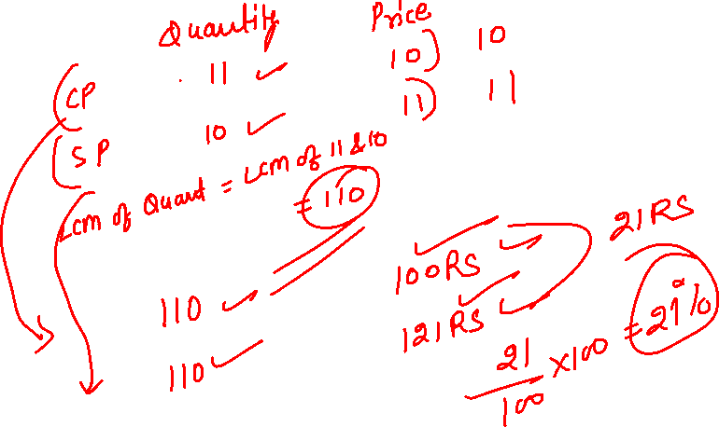
Question: A shopkeeper buy some number of article at the rate of 11 articles for Rs.10 and sold all of them at the rate of 10 articles for Rs.11. Find his profit or loss percent.
[A] 20 % profit
[B] 21% profit
[C] 25 % loss
[D] 21 % loss

Slide 8
Question: A Shopkeeper buy some lemons at rate of 2 for Rs.1.Again he bought the some number of lemons at rate of 1 for Rs.2. He mixed both the types and sold at 3 for Rs.3. find profit / loss %.
[A] 20 % loss
[B] 25 % loss
[C] 20 % profit
[D] 25 % profit

Slide 9
Question: A man purchase some number of articles at the rate of 11 articles for Rs.1. How many articles should he sell for Rs.1 to gain 10% profit.
[A] 11
[B] 10
[C] 12
[D] 14

Slide 10
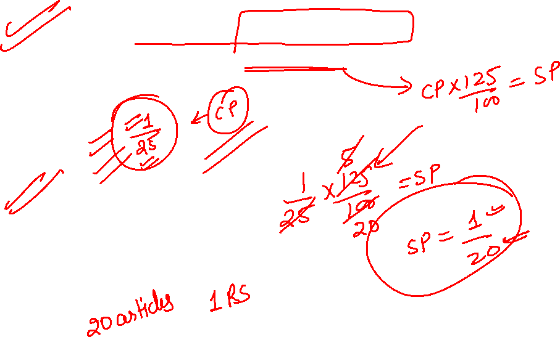
Question: A man purchase 25 articles for Rs.1. How many articles should he sell for Rs.1 to gain 25% profit.
[A] 21
[B] 28
[C] 20
[D] None

Slide 11
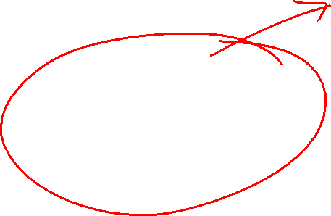
Faulty Weights (Dishonest Trader)

Slide 12
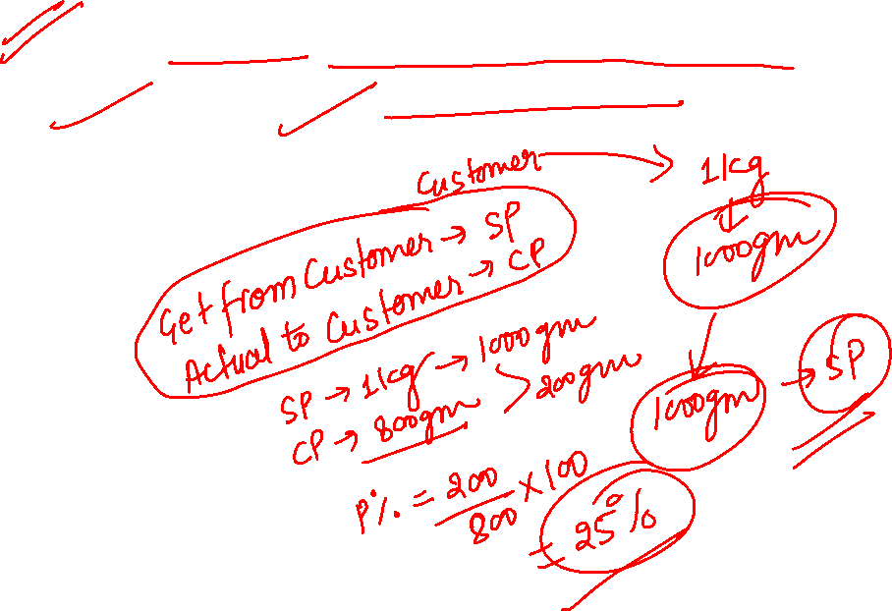
Question: A shopkeeper professes to sell his goods at its CP, But he uses 800 gm. In place of 1 kg. Find his profit percent.
[A] 25%
[B] 20%
[C] 33.33%
[D] 40%

Slide 13
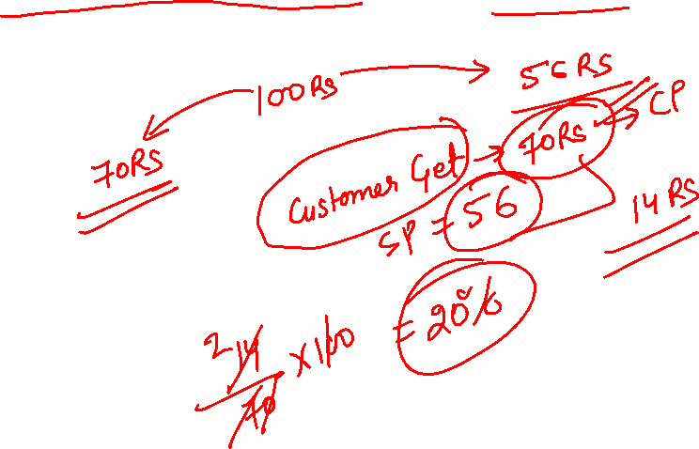
Question: A shopkeeper professes to sell his goods at 44% loss, But he uses 30% less weight. Find his profit or loss percent.
[A] 20% profit
[B] 25% profit
[C] 25% loss
[D] 20% loss

Slide 14
Question: A dishonest dealer professes to sell his goods at cost price but uses a weight of 960 gms instead of a kg weight. Find the gain of this dishonest person in percent.
A) 5(3/4)%
B) 4.167%
C) 5(1/6)%
D) None Of These

Slide 15
Question: A dishonest shopkeeper sells salt at a rate of Rs 18 per kilogram. The MRP of the salt is Rs 15 per kg. As though not satisfied with this, he tries to multiply his profit by removing 200 gm from each packet. What is the shopkeeper’s gain percentage? A) 15% B) 20% C) 25% D) 30%

Slide 16

Problems on Successive Discount

Slide 17
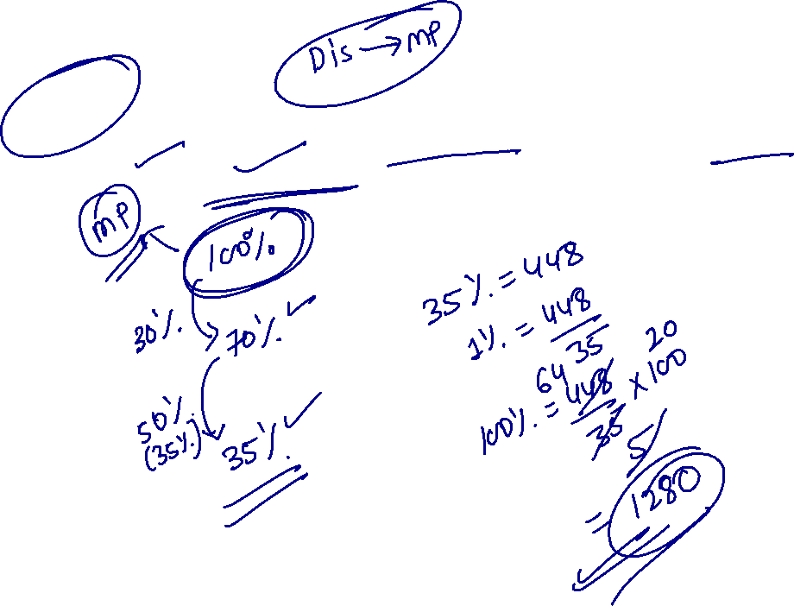
Questions: An item was sold at a price after giving two successive discount of 30% and 50 %. If the selling price of the item was Rs 448, then what was the marked price of the item?
[A] 840
[B] 1280
[C] 1140
[D] 1640

Slide 18
Question: Buy 5 articles get 3 articles free. Find discount percent.
[A] 33.33%
[B] 12.5%
[C] 37.5%
[D] 60%

Slide 19
Question: A shopkeeper gives 10% discount on an article and earn 20% profit then find his profit percent if he will give 20% discount on the same article.
[A] 16.66%
[B] 5.66%
[C] 6.66%
[D] None

Slide 20
Question: A shopkeeper give 1 article free of every purchase of 15 article and also gives a discount of 4 % and after all that his profit percent is 35%. Find CP:MP.
[A] 3:2
[B] 4:5
[C] 3:4
[D] 2:3

Slide 21
Question: A superstore marks its goods by a certain percentage over the past price and then offers a discount of 40%. Using this method, they make 5% profit. Find the percentage by which the goods were marked up. A. 60%
B. 70%
C. 72%
D. 75%

Slide 22
Question: A trader allows a discount of 10% on the market price of the goods. He still manages to make a profit of 17% on the cost price. What will be profit percentage had the trader sold the goods at the market price?
A. 10%
B. 20%
C. 30%
D. 40%

Slide 23


